Slide 1
Git and GitHub Git_Divansh

Slide 2
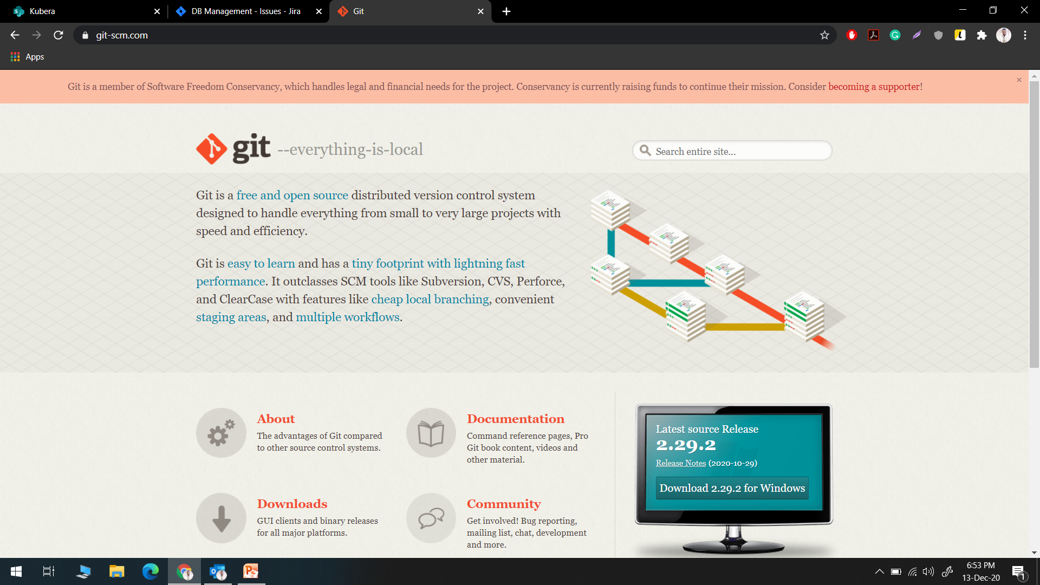
Git Website

Slide 3
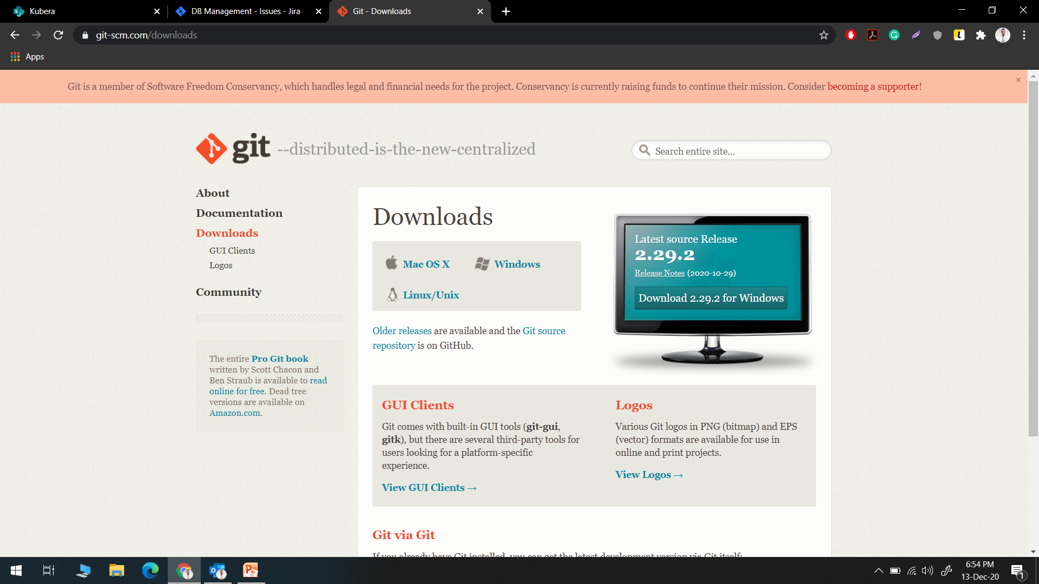
Selecting OS

Slide 4
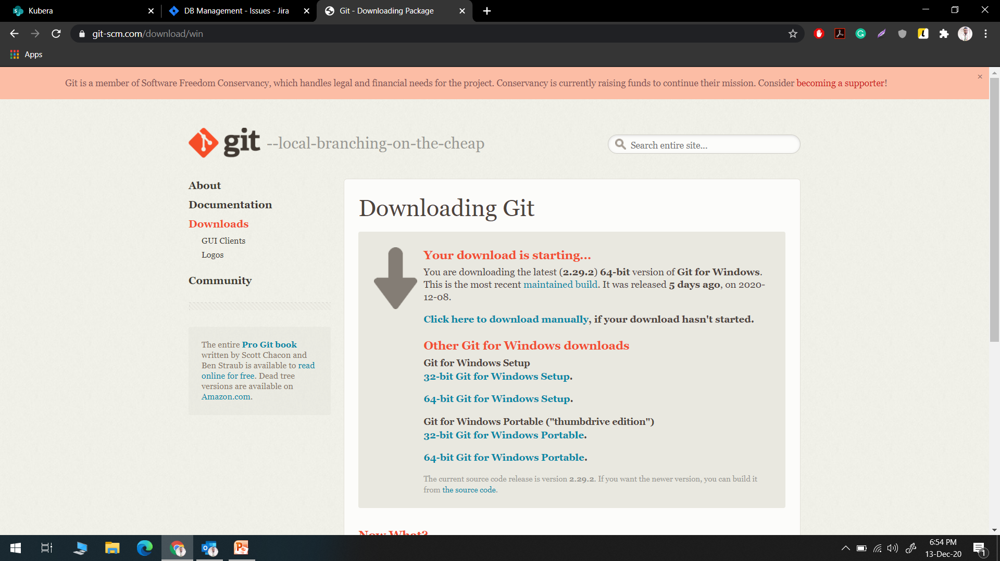
Download and Install Git

Slide 5

GitHub Home Page

Slide 6
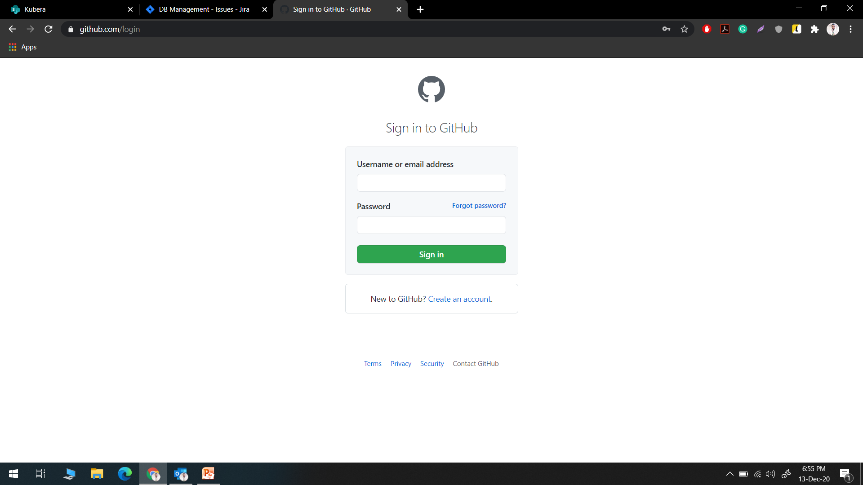
GitHub Sign in page

Slide 7
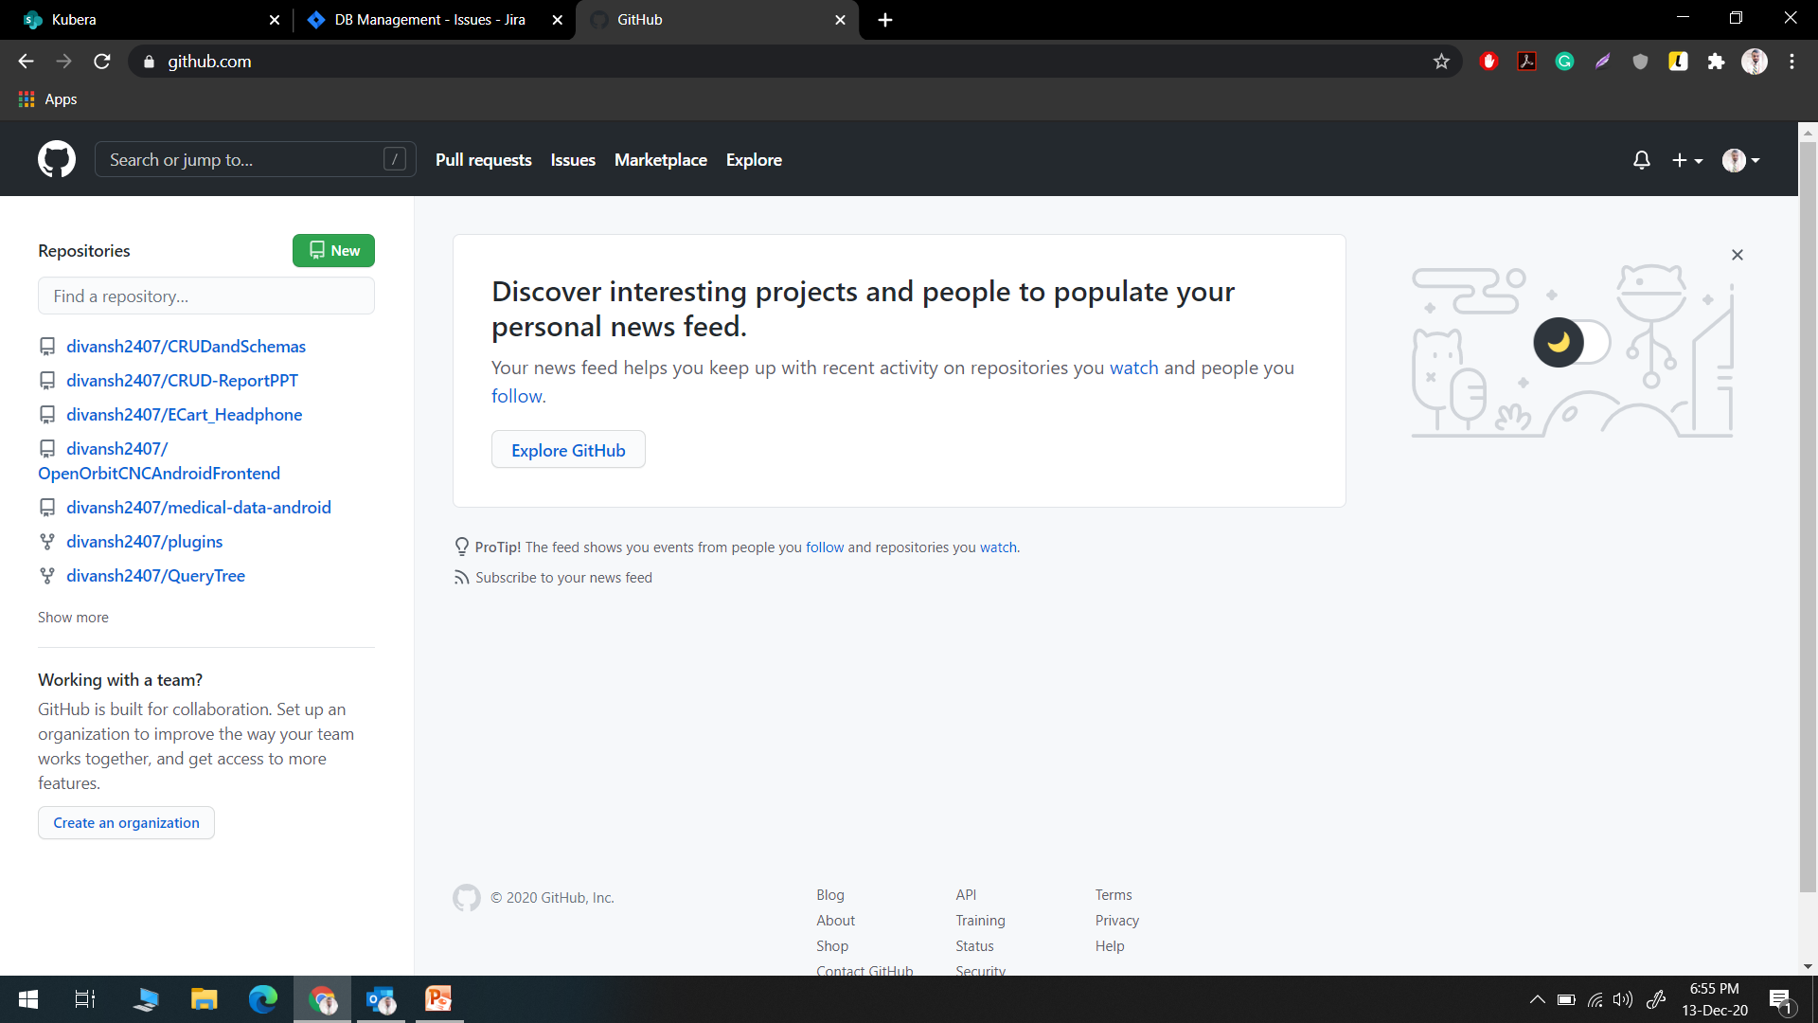
GitHub page after logged in

Slide 8
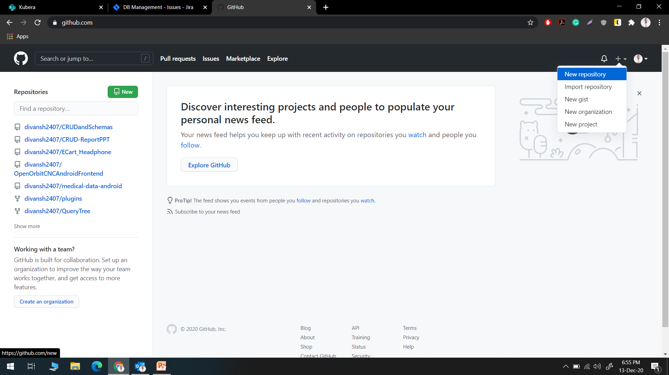
GitHub New Repository

Slide 9
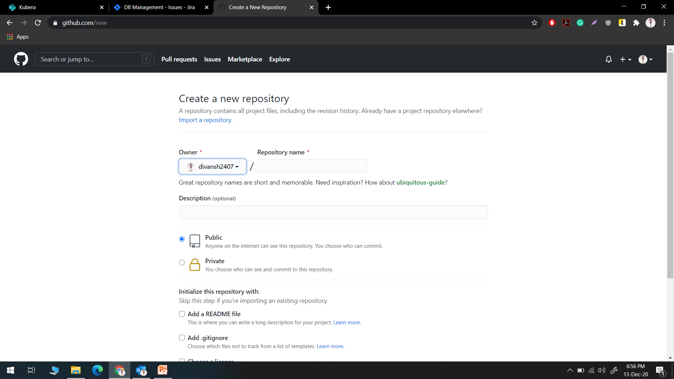
GitHub add repository name

Slide 10
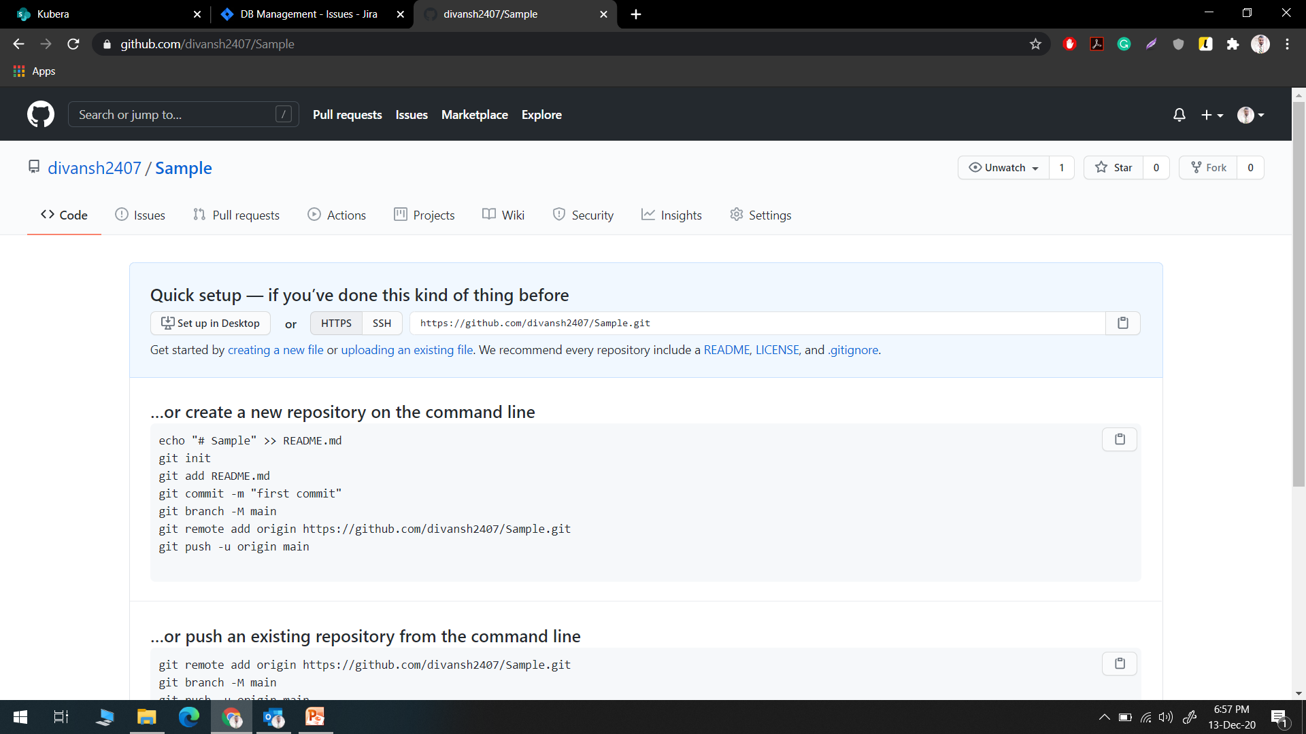
GitHub new blank repository

Slide 11
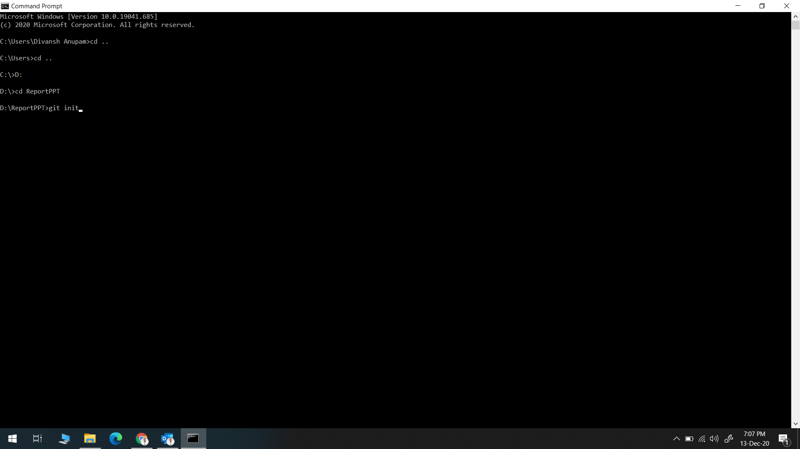
git init

Slide 12
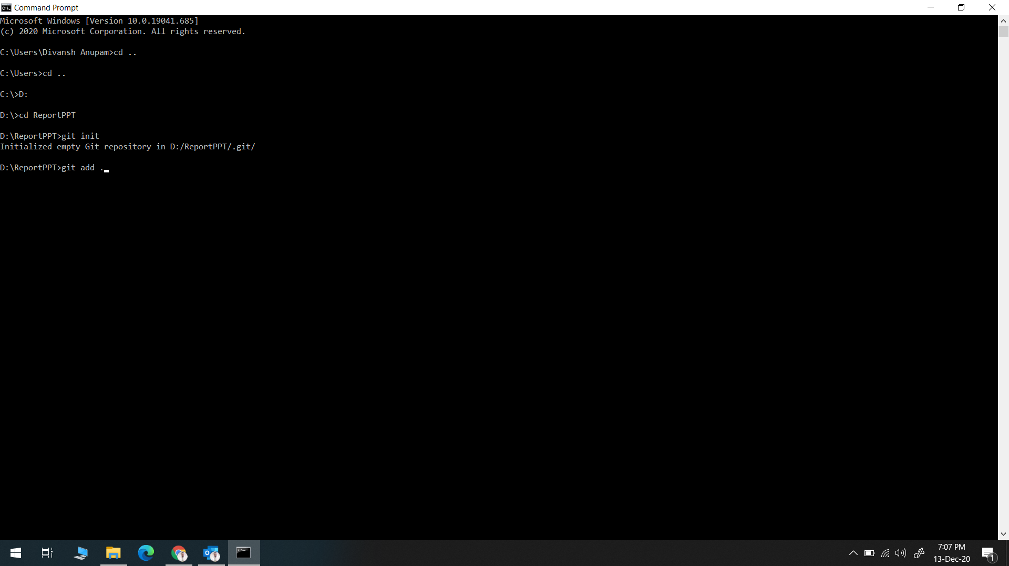
Add files to git

Slide 13
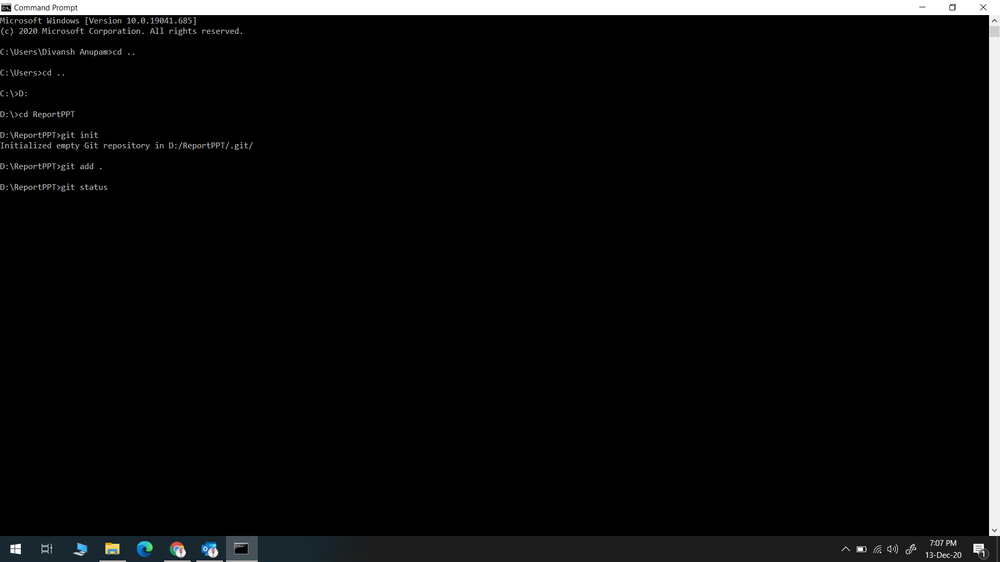
git status

Slide 14
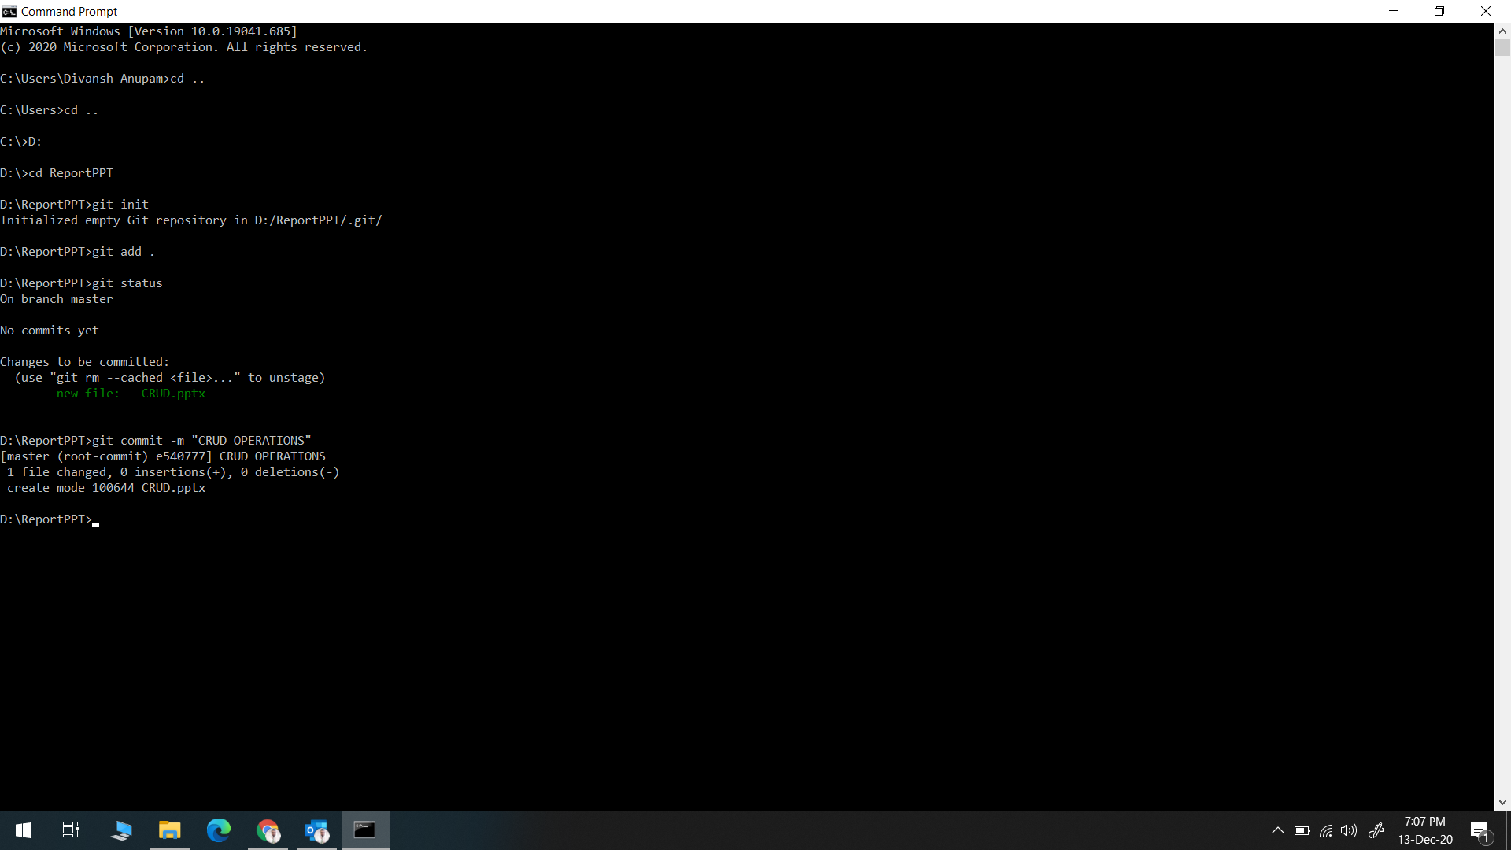
git commit with message

Slide 15
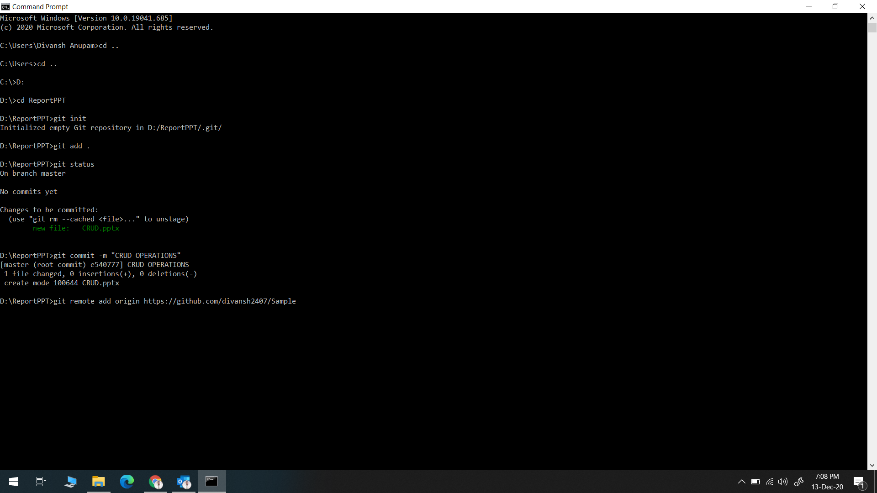
Link repository with local system

Slide 16
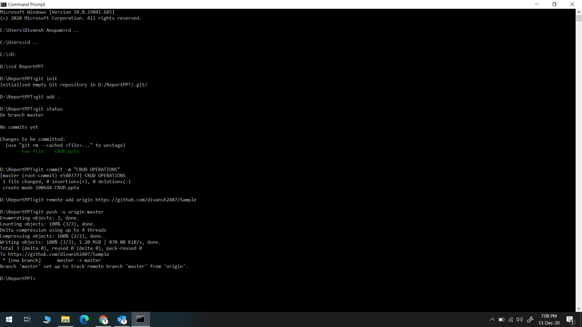
Push the files

Slide 17
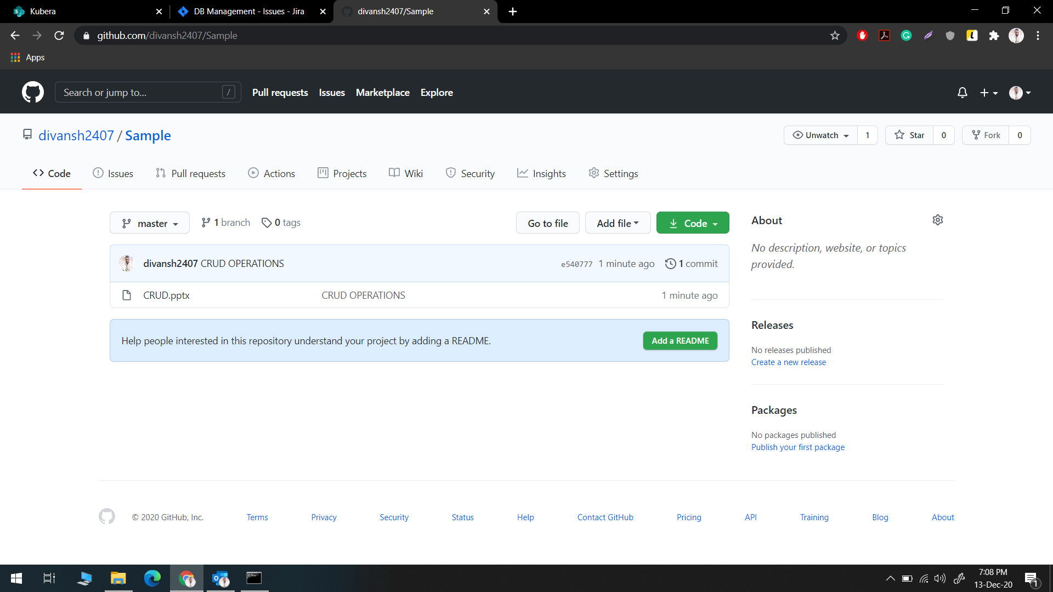
Files added in new repository

